Slide 1
Factor Markets

Slide 2

Factor of Production
used to produce some output.
also called an input or a productive resource.
examples: labor, machinery, raw materials, land

Slide 3
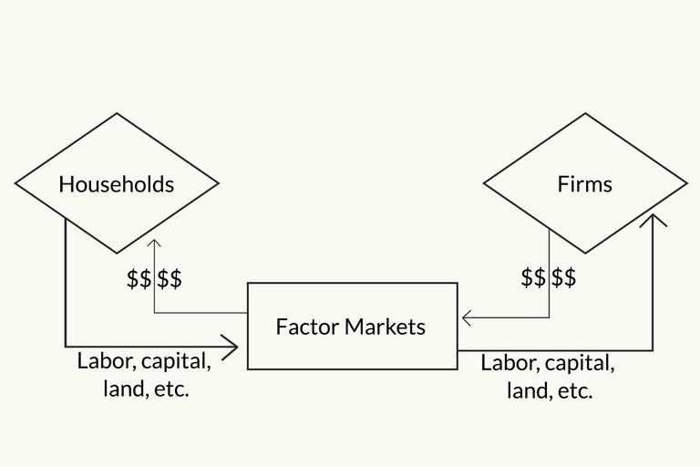
Factor Market
a market for a factor of production.
A factor market facilitates the purchase and sale of services of factors of production.
example: The market for construction workers brings together the buyers and sellers of construction workers’ services.

Slide 4
The demand for an input is derived from the demand for the output that the input helps produce.
Derived Demand

Slide 5
Note
A firm might be a perfect competitor in the product market and might not be a perfect competitor in the factor market, or vice versa.

Slide 6
Four Possibilities for a Firm
Perfect competitor in the product market, and perfect competitor in the factor market.
Perfect competitor in the product market, but
not a perfect competitor in the factor market.
Not a perfect competitor in the product market, but a perfect competitor in the factor market.
Not a perfect competitor in the product market, and not a perfect competitor in the factor market.

Slide 7
Example: The local water company is the only water company in the area. It is one of many employers who hire accountants.

Slide 8

Example: The local water company is the only water company in the area. It is one of many employers who hire accountants.
This firm is not a perfect competitor
in the product market (water market).

Slide 9

Example: The local water company is the only water company in the area. It is one of many employers who hire accountants.
This firm is not a perfect competitor
in the product market (water market).
It may be a perfect competitor in
the factor market (market for
accountants).

Slide 10
Example: A small mill town is owned by a textile company. The company is the only employer in town.

Slide 11
Example: A small mill town is owned by a textile company. The company is the only employer in town.
This firm may be a perfect competitor
in the product market (textile market).

Slide 12

Example: A small mill town is owned by a textile company. The company is the only employer in town.
This firm may be a perfect competitor
in the product market (textile market).
It is not a perfect competitor
in the factor market (labor
market).

Slide 13
Price-Taking in the Factor Market
Just as a firm in a perfectly competitive product market takes the price of the product as given, a firm in a perfectly competitive factor market takes the price of the factor as given.
The firm can hire as much of the input as it wants at the going input price.
So, the supply curve of the input to the firm is a horizontal line at the input price.

Slide 14
The Supply Curve of Labor to a Firm that is a Perfect Competitor in the Labor Market
price of labor
P_{L}
S
labor

Slide 15
Factor Market Terms

Slide 16
Marginal Resource Cost (MRC)
the change in total cost that results from the employment of an additional unit of an input.
MRC = ΔTC / ΔL

Slide 17
Marginal Physical Product (MPP) or Marginal Product (MP)
the change in the quantity of output that results from the employment of an additional unit of an input.
MPP = ΔQ / ΔL

Slide 18
Marginal Revenue Product (MRP)
the change in total revenue that results from the employment of an additional unit of an input.
MRP = ΔTR / ΔL

Slide 19
What is the difference between the MPP and MRP?
Suppose your company produces chairs.
The MPP tells how many more chairs you can make if you hire another worker.
The MRP tells how much more revenue you can make from the additional chairs produced by the additional worker

Slide 20
Alternative formula for MRP
MRP = ΔTR = ΔTR ΔQ
ΔL ΔL ΔQ
= ΔTR ΔQ
ΔQ ΔL
= MR . MPP
So, MRP = MR . MPP

Slide 21
Example: A firm sells its shirts in a perfectly competitive product market for $10 each.
L Q
0 0
10 70
20 130
30 180
40 220
50 250
60 270
70 280

Slide 22
Example: A firm sells its shirts in a perfectly competitive product market for $10 each.
L Q MPP=ΔQ/ΔL
0 0 ---
10 70 7
20 130 6
30 180 5
40 220 4
50 250 3
60 270 2
70 280 1

Slide 23
Example: A firm sells its shirts in a perfectly competitive product market for $10 each.
L Q MPP=ΔQ/ΔL TR=PQ
0 0 --- 0
10 70 7 700
20 130 6 1300
30 180 5 1800
40 220 4 2200
50 250 3 2500
60 270 2 2700
70 280 1 2800

Slide 24
Example: A firm sells its shirts in a perfectly competitive product market for $10 each.
L Q MPP=ΔQ/ΔL TR=PQ MR =ΔTR/ΔQ
0 0 --- 0 ---
10 70 7 700 10
20 130 6 1300 10
30 180 5 1800 10
40 220 4 2200 10
50 250 3 2500 10
60 270 2 2700 10
70 280 1 2800 10

Slide 25
Example: A firm sells its shirts in a perfectly competitive product market for $10 each.
MRP =ΔTR/ΔL
L Q MPP=ΔQ/ΔL TR=PQ MR =ΔTR/ΔQ MRP= MR•MPP
0 0 --- 0 --- ---
10 70 7 700 10 70
20 130 6 1300 10 60
30 180 5 1800 10 50
40 220 4 2200 10 40
50 250 3 2500 10 30
60 270 2 2700 10 20
70 280 1 2800 10 10

Slide 26
Focusing on the first and last columns of the previous table, we have the MRP schedule.
L MRP
0 ---
10 70
20 60
30 50
40 40
50 30
60 20
70 10

Slide 27
Plotting points we have a graph of the MRP curve.
MRP
70
60
50
40
30
20
10
MRP
labor
0 10 20 30 40 50 60 70

Slide 28
When should you employ more
of an input?
MRP > MRC employ more input
MRP < MRC cut back employment
MRP = MRC profit-maximizing
employment level

Slide 29
profit-maximizing condition for input usage:
MRP = MRC

Slide 30
MRC in a Perfectly Competitive Labor Market
Each time a firm hires another unit of labor, its cost increases by the price of the labor (P_{L}).
So for a firm in a perfectly competitive labor market, MRC = P_{L} .
(If a firm is not in a perfectly competitive labor market, this is not true.)

Slide 31
Suppose the firm in the example we considered earlier is also perfectly competitive in the labor market.
So the MRC is the same as the price of labor or the market wage.
Let’s see what the demand curve for labor is for this firm.
What we need to know is how many workers will be hired at various wage levels.

Slide 32
Remember: You hire workers as long as they add at least as much to revenues as to cost.
L MRP
0 ---
10 70
20 60
30 50
40 40
50 30
60 20
70 10
Suppose the market wage is $70. How many workers will you hire?
10
Suppose the market wage is $60. How many workers will you hire?
20
Suppose the market wage is $50. How many workers will you hire?
30
Suppose the market wage is $40. How many workers will you hire?
40

Slide 33
Remember we have been trying to determine what the demand curve for labor looks like for this firm.
All of our demand curve points have been points on the MRP curve.
The demand curve for labor by the firm is just (the downward sloping part of) the MRP curve.

Slide 34
A Firm’s Demand Curve for Labor
$
70
60
50
40
30
20
10
demand curve for labor
labor
0 10 20 30 40 50 60 70

